Slide 1



Rockbuster Launch Strategy Online Video Service
Carolina
Marcucci

Slide 2

Introduction
Rockbuster is a movie rental company that used to have stores around the world. Facing stiff competition from online streaming services the company is planning to use its existing licenses to launch an online video rental service in order to stay competitive. This presentation will cover the launch strategy for Rockbuster’s new product.
2

Slide 3
Key Questions &
Objectives
Which movies contributed the most/least to revenue gain?
What was the average rental duration for all videos?
Which countries are Rockbuster customers based in?
Where are customers with a high lifetime value based?
Do sales figures vary between geographic regions?
3

Slide 4
Data Overview
Metric | Min | Max | Average
Rental Rate ($) | 0.99 | 4.99 | 2.98
Rental Duration (Days) | 3 | 7 | 4.99
Film Length (mins) | 46 | 185 | 115.27
Replacement Cost ($) | 9.99 | 29.99 | 19.98
4

Slide 5
Which movies contributed the most/least to revenue gain?
1
5
Rockbuster - Launch Strategy Online Video Service

Slide 6
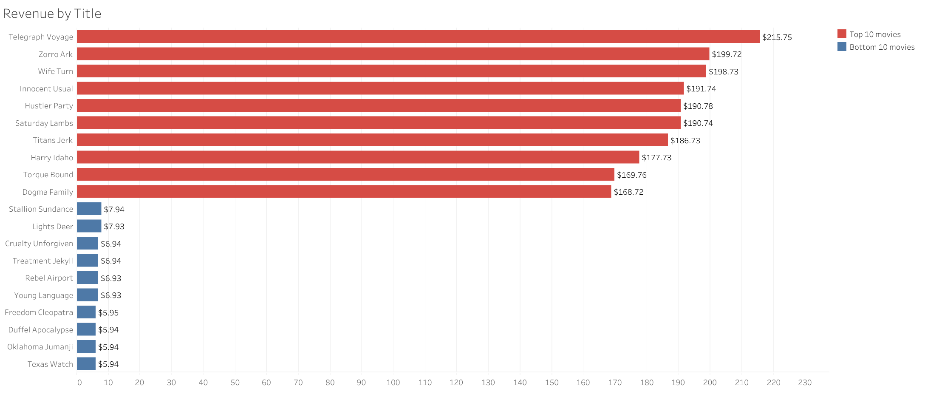
The top revenue-earning movies are Telegraph Voyage, Zorro Ark and Wife Turn.
The bottom revenue-earning movies are Duffel Apocalypse, Oklahoma Jumanji and Texas Watch.
6

Slide 7
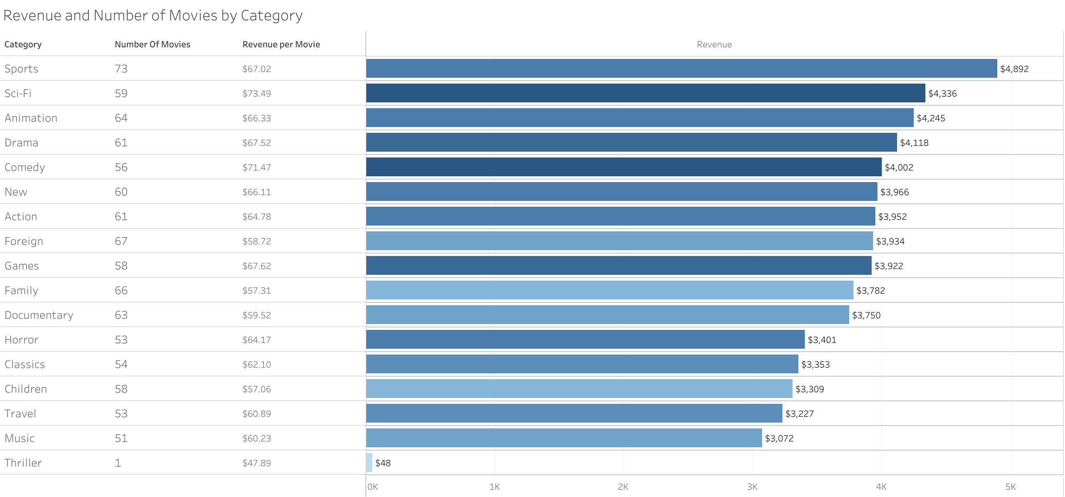
Sports, Sci-Fi and Animation are the top three revenue-earning genres.
Sci-Fi, Comedy and Games generate the highest revenue per movie
7

Slide 8
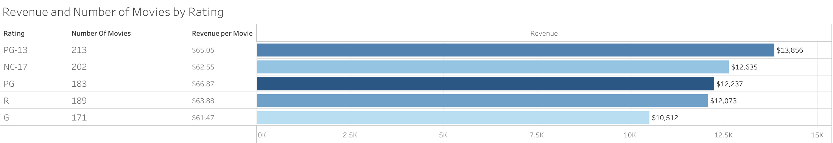
PG-13 is the top revenue-earning rating category followed by NC-17 and PG.
PG has the highest revenue per movie.
8

Slide 9
What was the average rental duration for all videos?
2
9
Rockbuster - Launch Strategy Online Video Service

Slide 10
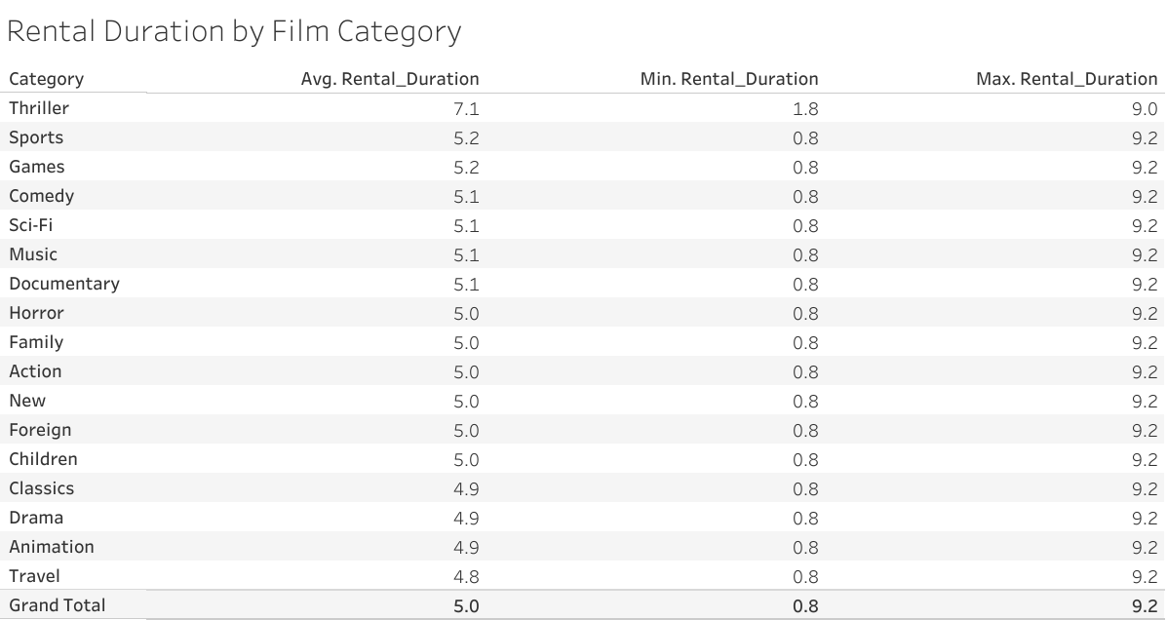
The average rental duration is 5 days.
Thriller movies have the longest average rental duration.
10

Slide 11
Which countries are Rockbuster customers based in?
3
11
Rockbuster - Launch Strategy Online Video Service

Slide 12
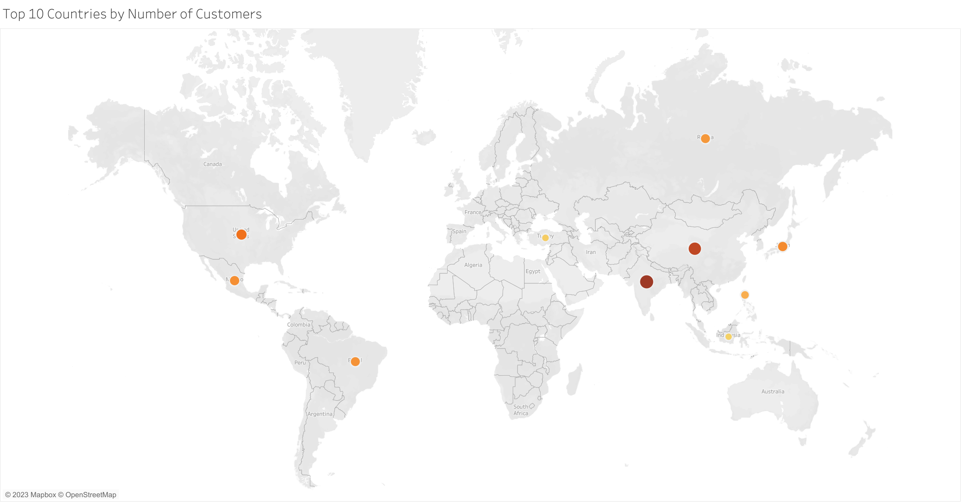
Country | Number of Customers | Revenue
India | 60 | $ 6,035
China | 53 | $ 5,251
United States | 36 | $ 3,685
Japan | 31 | $ 3,123
Mexico | 30 | $ 2,985
Brazil | 28 | $ 2,919
Russian Federation | 28 | $ 2,766
Philippines | 20 | $ 2,220
Turkey | 15 | $ 1,498
Indonesia | 14 | $ 1,353
Rockbusted customers are based primarily in India and China.
These countries are also the top revenue-earning countries for the company.
Rockbuster - Launch Strategy Online Video Service
12

Slide 13
Top 10 cities within Top 10 Countries
Country | City | Number of Customers
United States | Aurora | 2
Mexico | Acua | 1
United States | Citrus Heights | 1
Japan | Iwaki | 1
India | Ambattur | 1
China | Shanwei | 1
Brazil | So Leopoldo | 1
Russian Federation | Teboksary | 1
China | Tianjin | 1
Indonesia | Cianjur | 1
Rockbuster - Launch Strategy Online Video Service
13

Slide 14
Where are customers with a high lifetime value based?
4
14
Rockbuster - Launch Strategy Online Video Service

Slide 15
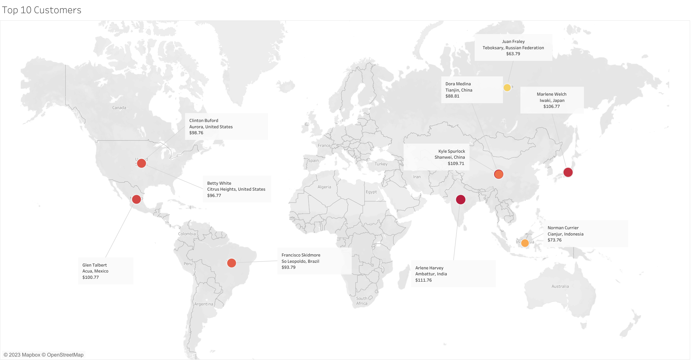
The top 3 customers are based in India, China and Japan.
Rockbuster - Launch Strategy Online Video Service
15

Slide 16
Do sales figures vary between geographic regions?
5
16
Rockbuster - Launch Strategy Online Video Service

Slide 17
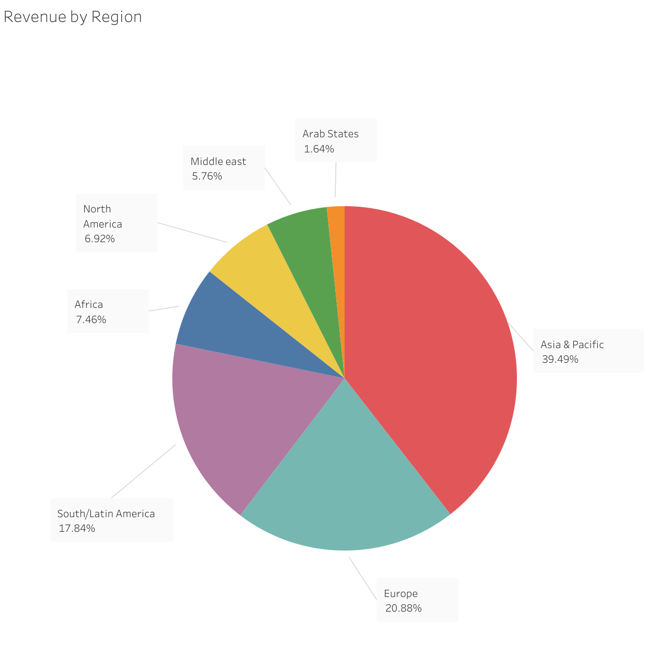
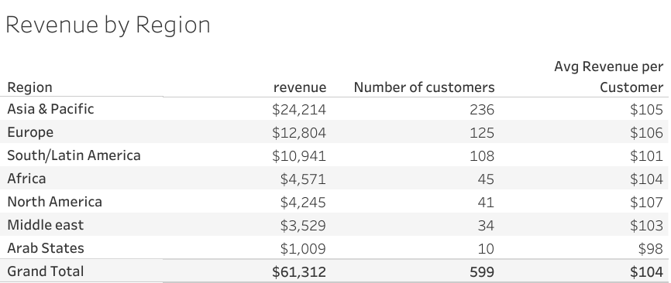
Asia Pacific, Europe and Latin America account for more than 75% of the global revenue.
Rockbuster - Launch Strategy Online Video Service
17

Slide 18
Recommendations
Inventory
Boosting movies that generate the most revenue and adding titles similar to the best-performing movies to the inventory.
Adding and boosting inventory from the categories that generate the highest revenue per movie: Sci-Fi, Comedy and Games.
Adding and boosting inventory from the ratings that generate the highest revenue per movie: PG and PG-13.
Adding local content in different languages.
Marketing
Focusing marketing efforts on regions where most of the clients are located: Asia Pacific, Europe and Latin America, and on North America, the region with the highest revenue per customer.
Focusing marketing efforts on India and China, where not only most of the clients are located, but also the top 2 customers are based in.
Rockbuster - Launch Strategy Online Video Service

Slide 19
Thank you
Carolina Marcucci
Rockbuster - Launch Strategy Online Video Service

